Slide 1
DP HKucheriProject3 - Google Slides

Slide 2
Kucheriya Clothing
1. Upload Images
Upload or take a picture for our AI bot to analyze.
2. Browse Items
Look through our various items and styles. Add your favorites to your basket to hold your items.
3. Try On Your Items
Once you’ve browsed through our selection of items, try them on virtually using our AI fashion technology.

Slide 3


Kucheriya Clothing
Upload from Photo Library
Take a new photo

Slide 4

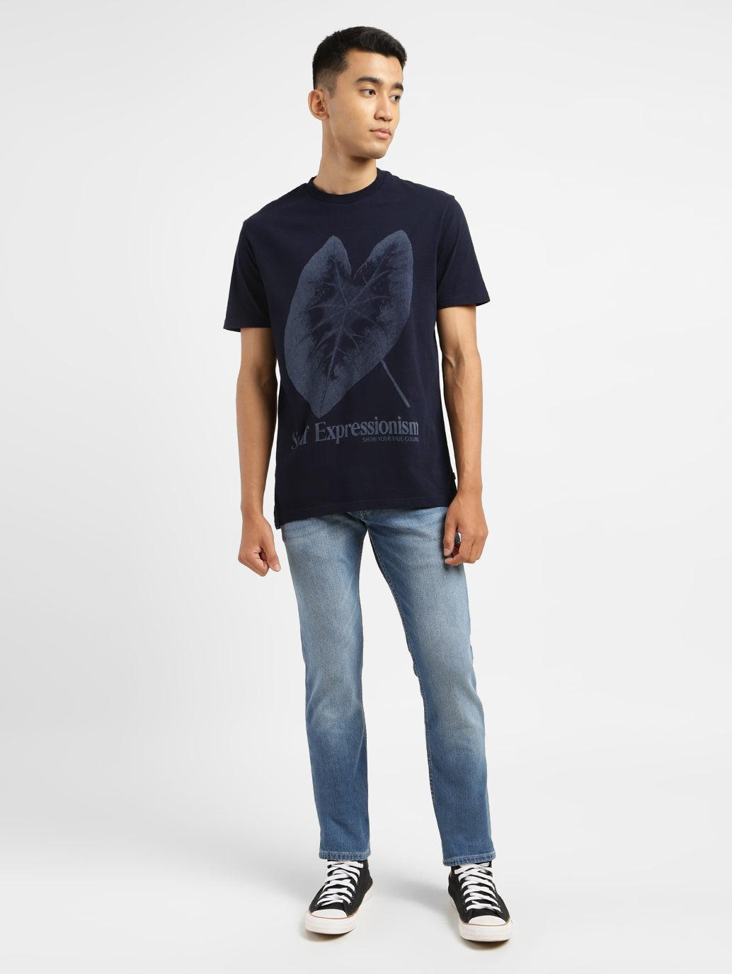
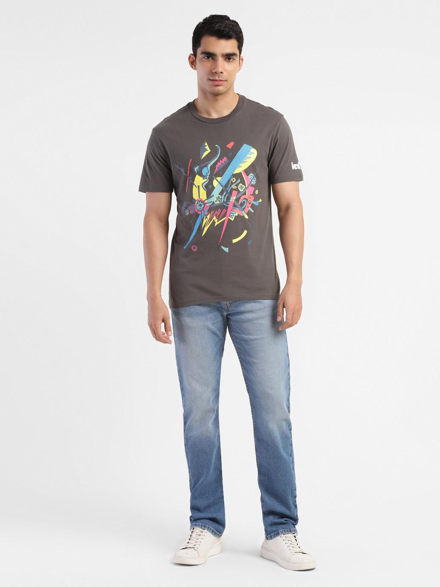
Kucheriya Clothing
Choose a photo from your library to upload
Next

Slide 5
Kucheriya Clothing
Choose a photo from your library to upload
Next

Slide 6
Kucheriya Clothing
Choose a photo from your library to upload
Next

Slide 7
Kucheriya Clothing
Choose a photo from your library to upload
Next

Slide 8



Kucheriya Clothing
Choose a photo from your library to upload

Slide 9
Kucheriya Clothing
Is this the photo you would like to proceed with?
Yes, Continue
No, Retake

Slide 10

Kucheriya Clothing
Your photo has been successfully Uploaded!
Browse Items
Back to Home

Slide 11


Kucheriya Clothing
Take a look at our various styles and looks
Tops - Start Here
Bottoms

Slide 12
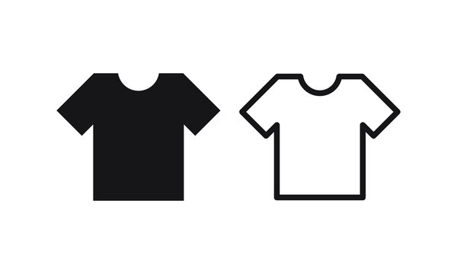
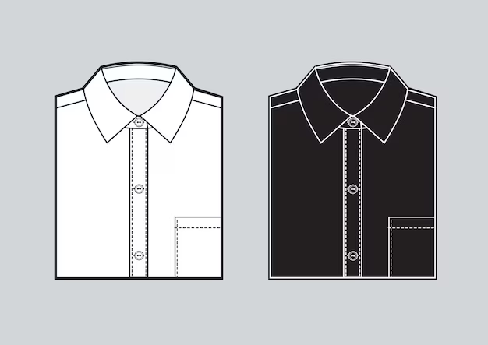
Kucheriya Clothing
Select A Top To Add To Your Basket
Color:
Basket
T-Shirt
Button-Down
Add
Add

Slide 13
Kucheriya Clothing
Home
Select A Top To Add To Your Basket
Color:
Basket
T-Shirt
Button-Down
Add
Add

Slide 14
Kucheriya Clothing
Home
Select A Top To Add To Your Basket
Color:
Basket
T-Shirt
Button-Down
White T-Shirt
Proceed to Bottoms
Add
Add

Slide 15
Kucheriya Clothing
Home
Select A Top To Add To Your Basket
Color:
Basket
T-Shirt
Button-Down
White Button-Down
Proceed to Bottoms
Add
Add

Slide 16
Kucheriya Clothing
Home
Select A Top To Add To Your Basket
Color:
Basket
T-Shirt
Button-Down
Black Button-Down
Proceed to Bottoms
Add
Add

Slide 17
Kucheriya Clothing
Home
Select A Top To Add To Your Basket
Color:
Basket
T-Shirt
Button-Down
Black T-shirt
Proceed to Bottoms
Add
Add

Slide 18


Kucheriya Clothing
Home
Select A Top To Add To Your Basket
Color:
Basket
Jeans
Shorts
Black T-shirt
Add
Add

Slide 19

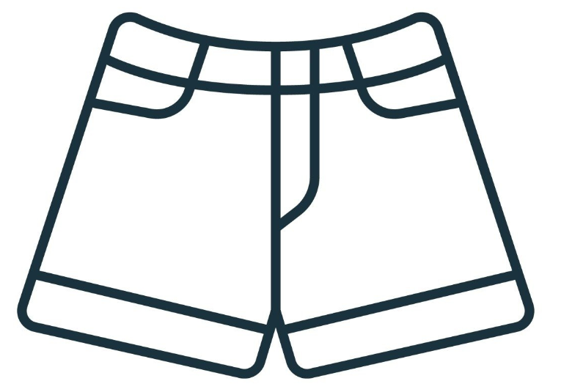
Kucheriya Clothing
Home
Select A Top To Add To Your Basket
Color:
Basket
Jeans
Shorts
Black T-shirt
Add
Add

Slide 20
Kucheriya Clothing
Home
Select A Top To Add To Your Basket
Color:
Basket
Jeans
Shorts
Black T-shirt
Black Jeans
Continue to Basket
Add
Add

Slide 21
Kucheriya Clothing
Home
Select A Top To Add To Your Basket
Color:
Basket
Jeans
Shorts
Black T-shirt
Black Shorts
Continue to Basket
Add
Add

Slide 22
Kucheriya Clothing
Home
Select A Top To Add To Your Basket
Color:
Basket
Jeans
Shorts
Black T-shirt
White Jeans
Continue to Basket
Add
Add

Slide 23
Kucheriya Clothing
Home
Select A Top To Add To Your Basket
Color:
Basket
Jeans
Shorts
Black T-shirt
White Shorts
Continue to Basket
Add
Add

Slide 24
Kucheriya Clothing
Home
Select A Top To Add To Your Basket
Color:
Basket
Jeans
Shorts
Black Button-Down
Add
Add

Slide 25
Kucheriya Clothing
Home
Select A Top To Add To Your Basket
Color:
Basket
Jeans
Shorts
Black Button-Down
Add
Add

Slide 26
Kucheriya Clothing
Home
Select A Top To Add To Your Basket
Color:
Basket
Jeans
Shorts
Black Button-Down
Black Jeans
Continue to Basket
Add
Add

Slide 27
Kucheriya Clothing
Home
Select A Top To Add To Your Basket
Color:
Basket
Jeans
Shorts
Black Button-Down
Black Shorts
Continue to Basket
Add
Add

Slide 28
Kucheriya Clothing
Home
Select A Top To Add To Your Basket
Color:
Basket
Jeans
Shorts
Black Button-Down
White Jeans
Continue to Basket
Add
Add

Slide 29
Kucheriya Clothing
Home
Select A Top To Add To Your Basket
Color:
Basket
Jeans
Shorts
Black Button-Down
White Shorts
Continue to Basket
Add
Add

Slide 30
Kucheriya Clothing
Home
Select A Top To Add To Your Basket
Color:
Basket
Jeans
Shorts
White Button-Down
Add
Add

Slide 31
Kucheriya Clothing
Home
Select A Top To Add To Your Basket
Color:
Basket
Jeans
Shorts
White Button-Down
Add
Add

Slide 32
Kucheriya Clothing
Home
Select A Top To Add To Your Basket
Color:
Basket
Jeans
Shorts
White Button-Down
Black Jeans
Continue to Basket
Add
Add

Slide 33
Kucheriya Clothing
Home
Select A Top To Add To Your Basket
Color:
Basket
Jeans
Shorts
White Button-Down
Black Shorts
Continue to Basket
Add
Add

Slide 34
Kucheriya Clothing
Home
Select A Top To Add To Your Basket
Color:
Basket
Jeans
Shorts
White Button-Down
White Jeans
Continue to Basket
Add
Add

Slide 35
Kucheriya Clothing
Home
Select A Top To Add To Your Basket
Color:
Basket
Jeans
Shorts
White Button-Down
White Shorts
Continue to Basket
Add
Add

Slide 36
Kucheriya Clothing
Home
Select A Top To Add To Your Basket
Color:
Basket
Jeans
Shorts
White T-Shirt
Add
Add

Slide 37
Kucheriya Clothing
Home
Select A Top To Add To Your Basket
Color:
Basket
Jeans
Shorts
White T-Shirt
Add
Add

Slide 38
Kucheriya Clothing
Home
Select A Top To Add To Your Basket
Color:
Basket
Jeans
Shorts
White T-Shirt
Black Jeans
Continue to Basket
Add
Add

Slide 39
Kucheriya Clothing
Home
Select A Top To Add To Your Basket
Color:
Basket
Jeans
Shorts
White T-Shirt
Black Shorts
Continue to Basket
Add
Add

Slide 40
Kucheriya Clothing
Home
Select A Top To Add To Your Basket
Color:
Basket
Jeans
Shorts
White T-Shirt
White Jeans
Continue to Basket
Add
Add

Slide 41
Kucheriya Clothing
Home
Select A Top To Add To Your Basket
Color:
Basket
Jeans
Shorts
White T-Shirt
White Shorts
Continue to Basket
Add
Add

Slide 42
Kucheriya Clothing
Home
Basket
Black T - Shirt
Black Jeans
Size:
Size:

Slide 43
Kucheriya Clothing
Home
Basket
Black T - Shirt
Black Jeans
Size:
Size:
Medium
Medium
Try On Your Items

Slide 44
Kucheriya Clothing
Home
Basket
Black T - Shirt
Black Shorts
Size:
Size:

Slide 45
Kucheriya Clothing
Home
Basket
Black T - Shirt
Black Shorts
Size:
Size:
Medium
Medium
Try On Your Items

Slide 46
Kucheriya Clothing
Home
Basket
Black T - Shirt
White Jeans
Size:
Size:

Slide 47
Kucheriya Clothing
Home
Basket
Black T - Shirt
White Jeans
Size:
Size:
Medium
Medium
Try On Your Items

Slide 48
Kucheriya Clothing
Home
Basket
Black T - Shirt
White Shorts
Size:
Size:

Slide 49
Kucheriya Clothing
Home
Basket
Black T - Shirt
White Shorts
Size:
Size:
Medium
Medium
Try On Your Items

Slide 50
Kucheriya Clothing
Home
Basket
White T - Shirt
Black Jeans
Size:
Size:

Slide 51
Kucheriya Clothing
Home
Basket
White T - Shirt
Black Jeans
Size:
Size:
Medium
Medium
Try On Your Items

Slide 52
Kucheriya Clothing
Home
Basket
White T - Shirt
Black Shorts
Size:
Size:

Slide 53
Kucheriya Clothing
Home
Basket
White T - Shirt
Black Shorts
Size:
Size:
Medium
Medium
Try On Your Items

Slide 54
Kucheriya Clothing
Home
Basket
Black Button-Down
Black Jeans
Size:
Size:

Slide 55
Kucheriya Clothing
Home
Basket
Black Button-Down
Black Jeans
Size:
Size:
Medium
Medium
Try On Your Items

Slide 56
Kucheriya Clothing
Home
Basket
Black Button-Down
Black Shorts
Size:
Size:

Slide 57
Kucheriya Clothing
Home
Basket
Black Button-Down
Black Shorts
Size:
Size:
Medium
Medium
Try On Your Items

Slide 58
Kucheriya Clothing
Home
Basket
Black Button-Down
White Shorts
Size:
Size:

Slide 59
Kucheriya Clothing
Home
Basket
Black Button-Down
White Shorts
Size:
Size:
Medium
Medium
Try On Your Items

Slide 60
Kucheriya Clothing
Home
Basket
Black Button-Down
White Jeans
Size:
Size:

Slide 61
Kucheriya Clothing
Home
Basket
Black Button-Down
White Jeans
Size:
Size:
Medium
Medium
Try On Your Items

Slide 62
Kucheriya Clothing
Home
Basket
White Button-Down
Black Jeans
Size:
Size:

Slide 63
Kucheriya Clothing
Home
Basket
White Button-Down
Black Jeans
Size:
Size:
Medium
Medium
Try On Your Items

Slide 64
Kucheriya Clothing
Home
Basket
White Button-Down
Black Shorts
Size:
Size:

Slide 65
Kucheriya Clothing
Home
Basket
White Button-Down
Black Shorts
Size:
Size:
Medium
Medium
Try On Your Items

Slide 66
Kucheriya Clothing
Home
Basket
White Button-Down
White Jeans
Size:
Size:

Slide 67
Kucheriya Clothing
Home
Basket
White Button-Down
White Jeans
Size:
Size:
Medium
Medium
Try On Your Items

Slide 68
Kucheriya Clothing
Home
Basket
White Button-Down
White Shorts
Size:
Size:

Slide 69
Kucheriya Clothing
Home
Basket
White Button-Down
White Shorts
Size:
Size:
Medium
Medium
Try On Your Items

Slide 70
Kucheriya Clothing
Home
Basket
White T-Shirt
White Shorts
Size:
Size:

Slide 71
Kucheriya Clothing
Home
Basket
White T-Shirt
White Shorts
Size:
Size:
Medium
Medium
Try On Your Items

Slide 72
Kucheriya Clothing
Home
Basket
White T-Shirt
White Jeans
Size:
Size:

Slide 73
Kucheriya Clothing
Home
Basket
White T-Shirt
White Jeans
Size:
Size:
Medium
Medium
Try On Your Items

Slide 74
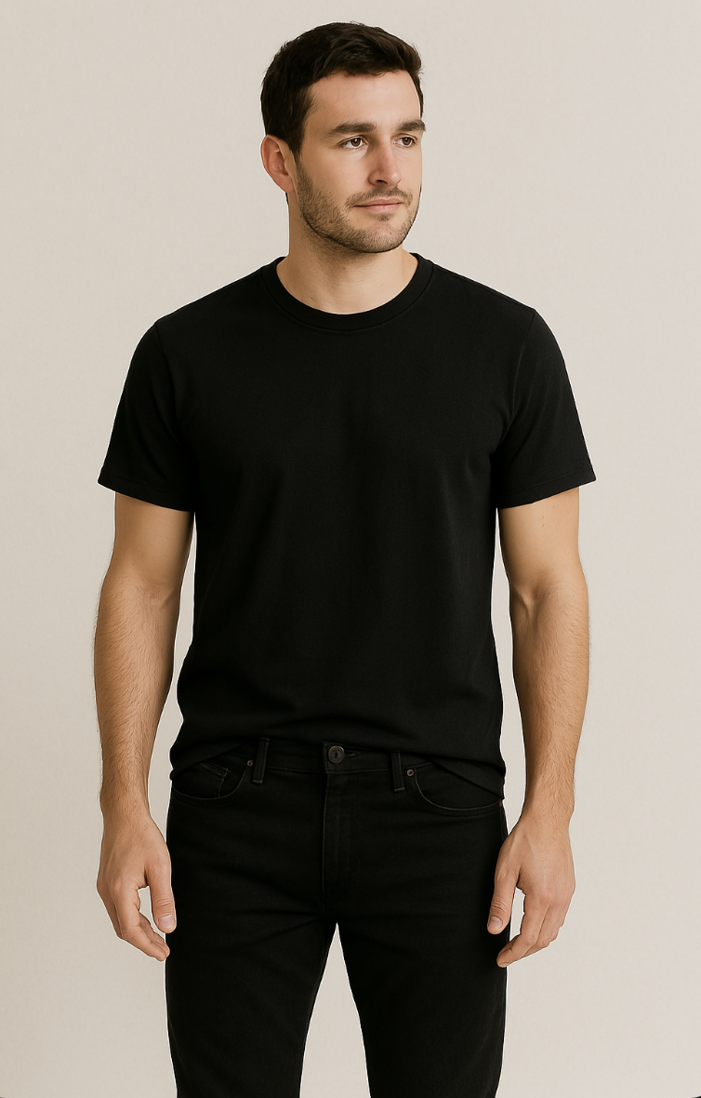
Kucheriya Clothing
Home
Trail Room
Your cart: Black T-shirt, Black Jeans
Continue

Slide 75
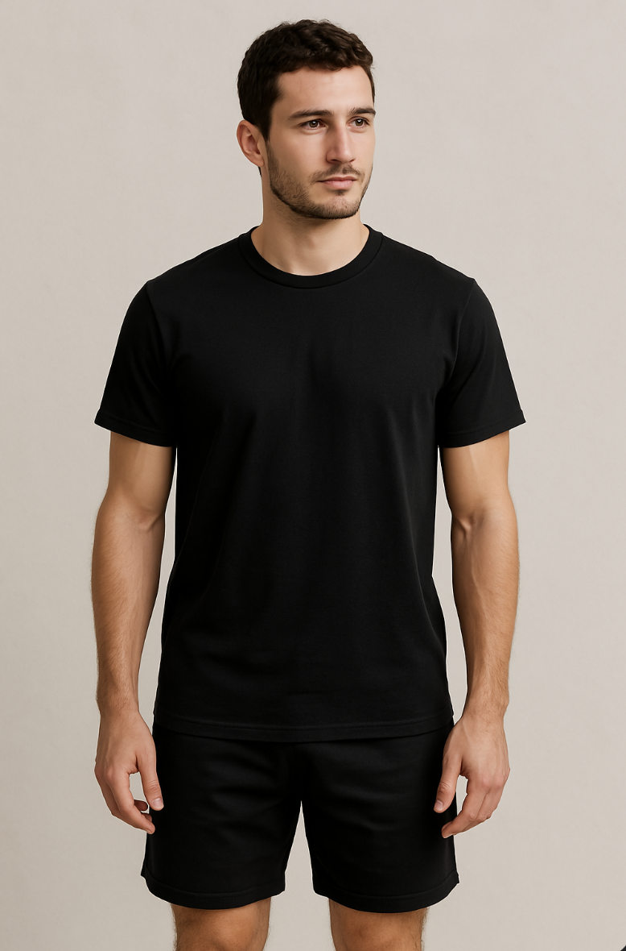
Kucheriya Clothing
Home
Trail Room
Your cart: Black T-shirt, Black Shorts
Continue

Slide 76
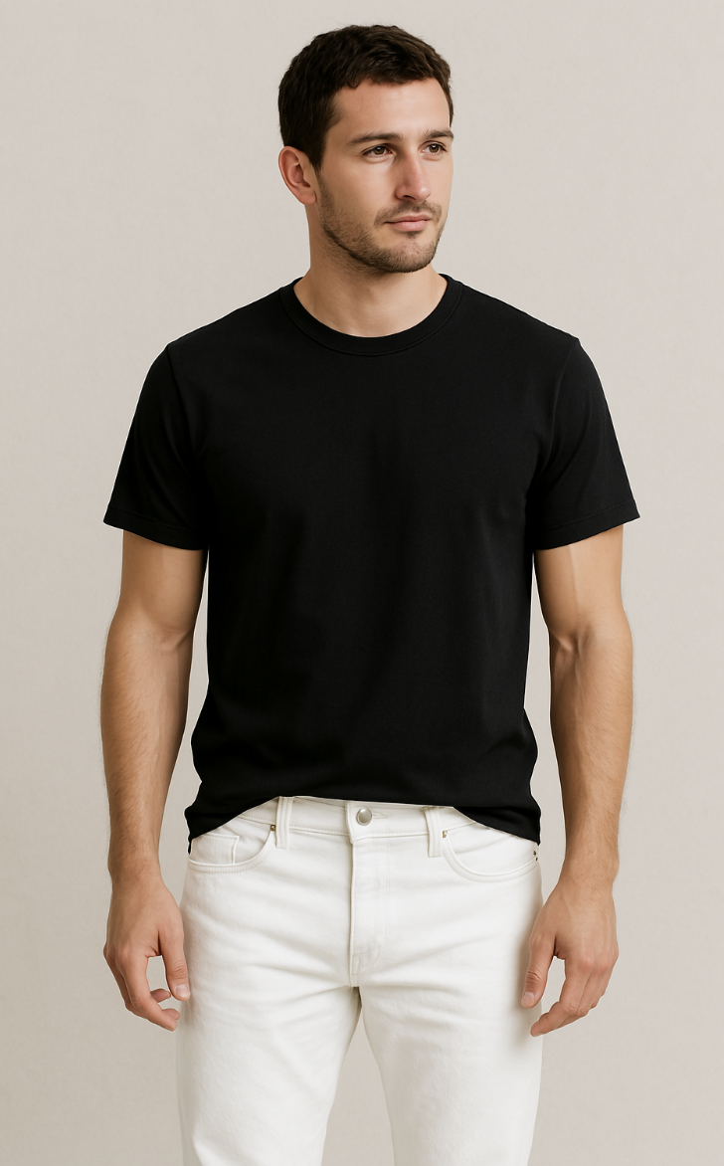
Kucheriya Clothing
Home
Trail Room
Your cart: Black T-shirt, White Jeans
Continue

Slide 77
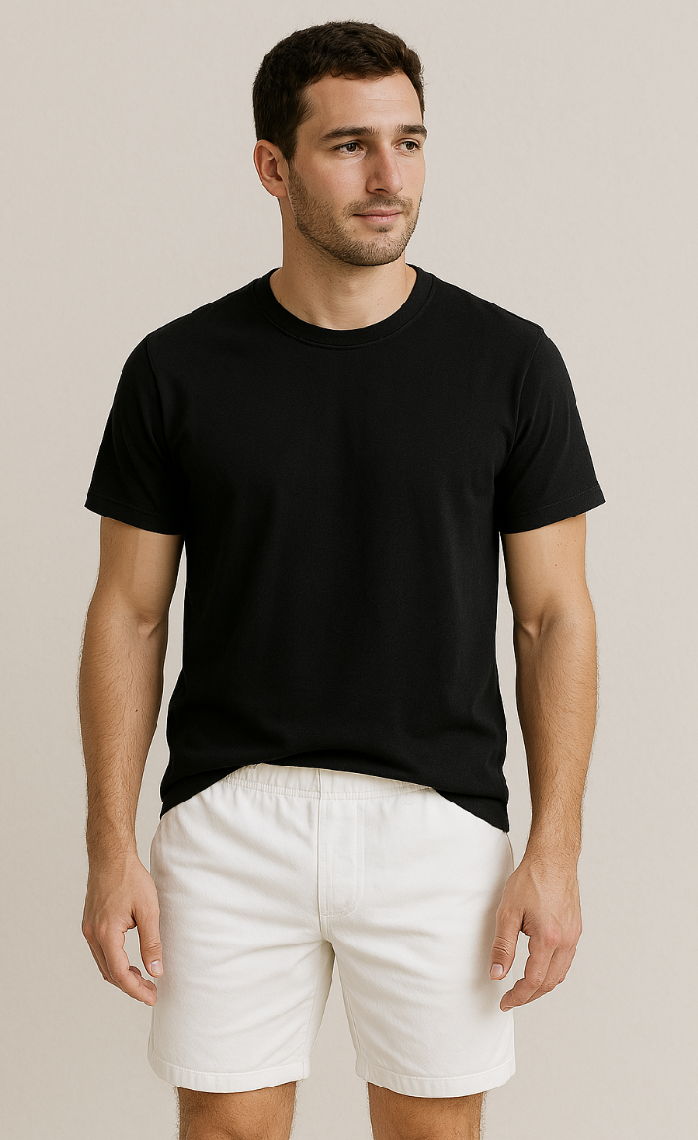
Kucheriya Clothing
Home
Trail Room
Your cart: Black T-shirt, White Shorts
Continue

Slide 78

Kucheriya Clothing
Home
Trail Room
Your cart: White T-shirt, Black Jeans
Continue

Slide 79
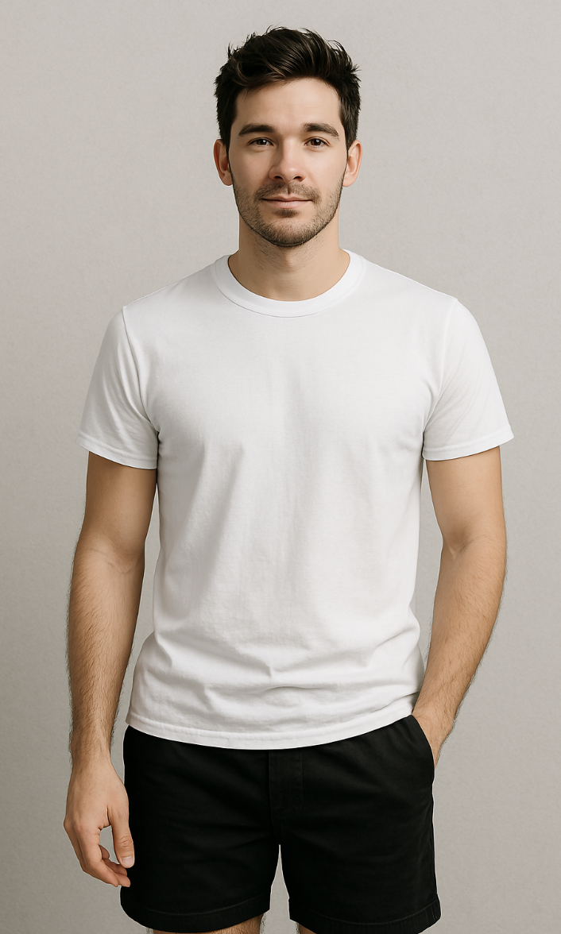
Kucheriya Clothing
Home
Trail Room
Your cart: White T-shirt, Black Shorts
Continue

Slide 80

Kucheriya Clothing
Home
Trail Room
Your cart: Black Button-down shirt, Black Jeans
Continue

Slide 81
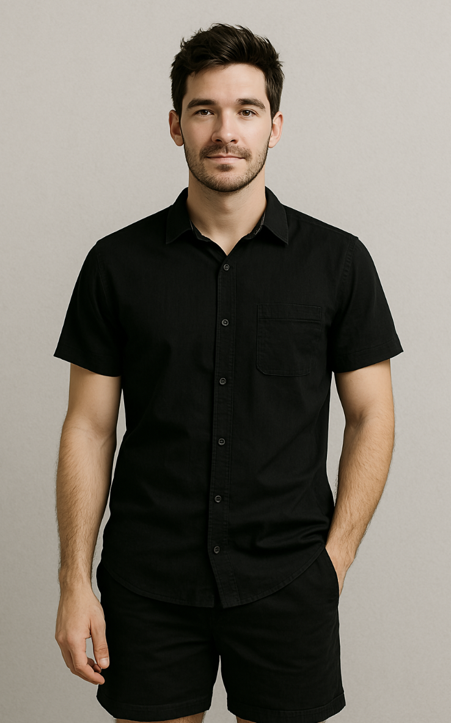
Kucheriya Clothing
Home
Trail Room
Your cart: Black Button-down shirt, Black Shorts
Continue

Slide 82
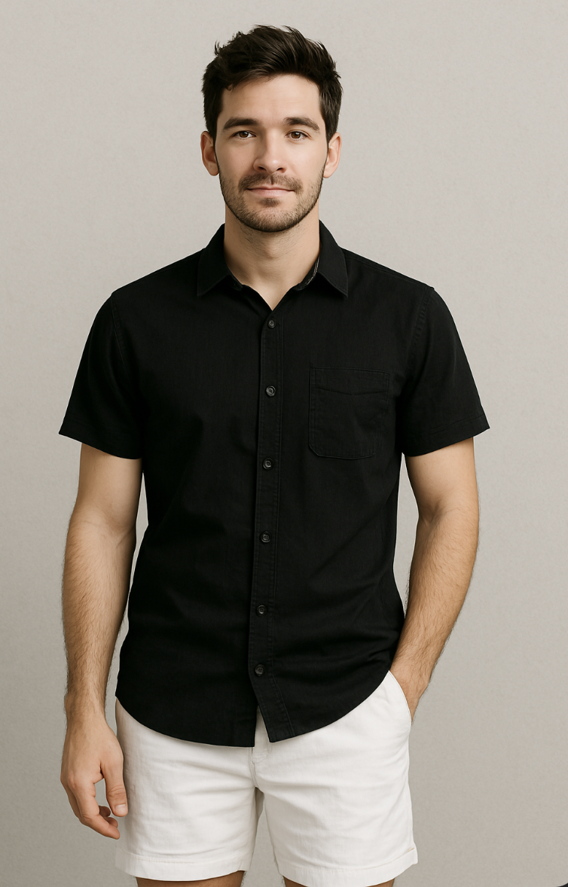
Kucheriya Clothing
Home
Trail Room
Your cart: Black Button-down shirt, White Shorts
Continue

Slide 83

Kucheriya Clothing
Home
Trail Room
Your cart: Black Button-down shirt, White Jeans
Continue

Slide 84
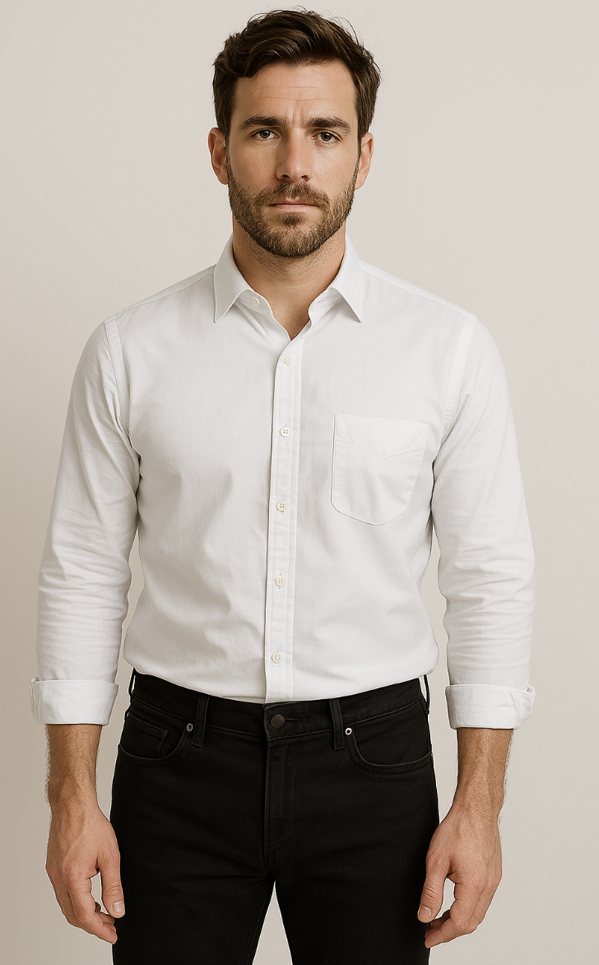
Kucheriya Clothing
Home
Trail Room
Your cart: White Button-down shirt, Black Jeans
Continue

Slide 85
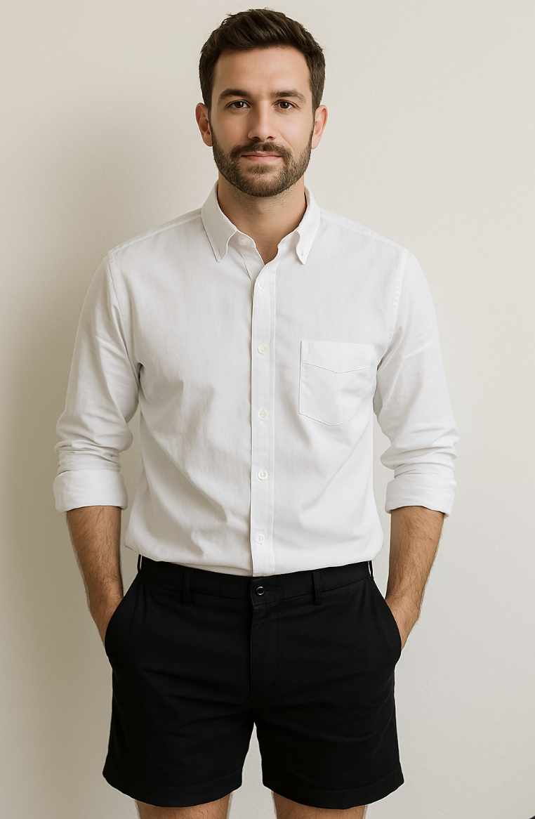
Kucheriya Clothing
Home
Trail Room
Your cart: White Button-down shirt, Black Shorts
Continue

Slide 86

Kucheriya Clothing
Home
Trail Room
Your cart: White Button-down shirt, White Jeans
Continue

Slide 87
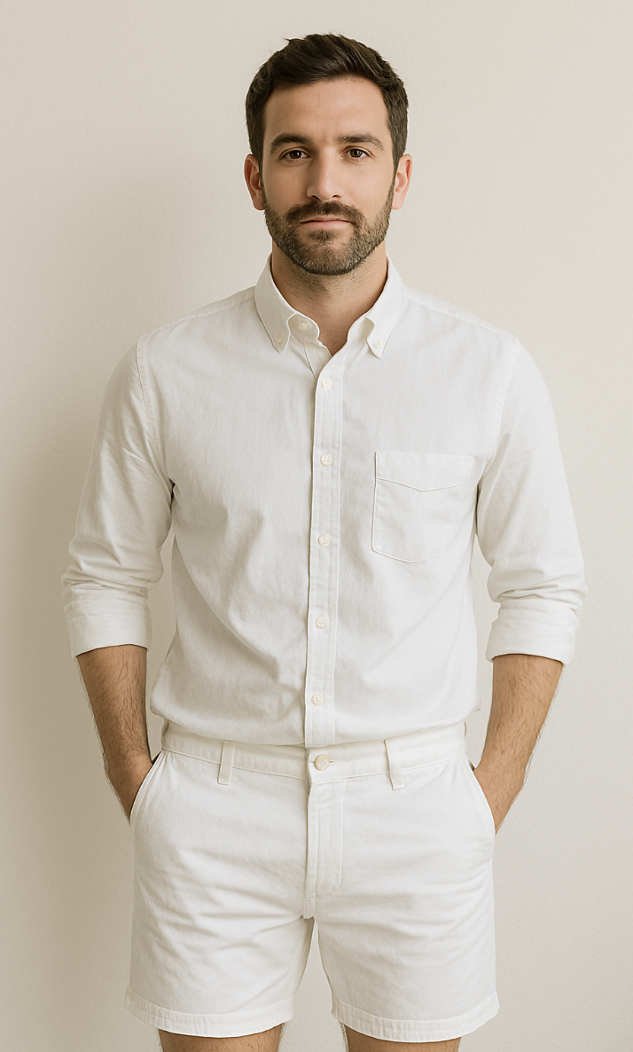
Kucheriya Clothing
Home
Trail Room
Your cart: White Button-down shirt, White Shorts
Continue

Slide 88
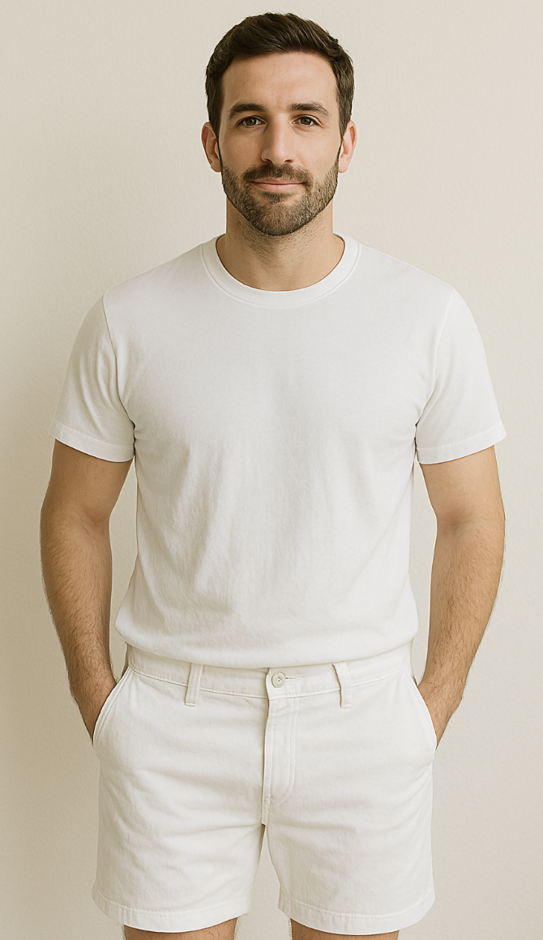
Kucheriya Clothing
Home
Trail Room
Your cart: White T-Shirt, White Shorts
Continue

Slide 89

Kucheriya Clothing
Home
Trail Room
Your cart: White T-Shirt, White Jeans
Continue

Slide 90
Kucheriya Clothing
Home
Trail Room
Confirm Selection
Your cart: White T-Shirt, White Jeans
Confirm your items: Black T-Shirt and Black Jeans. Give a name to your style.
Enter name
Change Top
Change Bottom
Confirm
Cancel
Continue

Slide 91
Kucheriya Clothing
Home
Trail Room
Confirm Selection
Your cart: White T-Shirt, White Jeans
Confirm your items: Black T-Shirt and Black Shorts. Give a name to your style.
Enter name
Change Top
Change Bottom
Confirm
Cancel
Continue

Slide 92
Kucheriya Clothing
Home
Trail Room
Confirm Selection
Your cart: White T-Shirt, White Jeans
Confirm your items: Black T-Shirt and White Jeans. Give a name to your style.
Enter name
Change Top
Change Bottom
Confirm
Cancel
Continue

Slide 93
Kucheriya Clothing
Home
Trail Room
Confirm Selection
Your cart: White T-Shirt, White Jeans
Confirm your items: Black T-Shirt and White Shorts. Give a name to your style.
Enter name
Change Top
Change Bottom
Confirm
Cancel
Continue

Slide 94
Kucheriya Clothing
Home
Trail Room
Confirm Selection
Your cart: White T-Shirt, White Jeans
Confirm your items: White T-Shirt and Black Jeans. Give a name to your style.
Enter name
Change Top
Change Bottom
Confirm
Cancel
Continue

Slide 95
Kucheriya Clothing
Home
Trail Room
Confirm Selection
Your cart: White T-Shirt, White Jeans
Confirm your items: White T-Shirt and Black Shorts. Give a name to your style.
Enter name
Change Top
Change Bottom
Confirm
Cancel
Continue

Slide 96
Kucheriya Clothing
Home
Trail Room
Confirm Selection
Your cart: White T-Shirt, White Jeans
Confirm your items: Black Button down Shirt and Black Jeans. Give a name to your style.
Enter name
Change Top
Change Bottom
Confirm
Cancel
Continue

Slide 97
Kucheriya Clothing
Home
Trail Room
Confirm Selection
Your cart: White T-Shirt, White Jeans
Confirm your items: Black Button down Shirt and Black Shorts. Give a name to your style.
Enter name
Change Top
Change Bottom
Confirm
Cancel
Continue

Slide 98
Kucheriya Clothing
Home
Trail Room
Confirm Selection
Your cart: White T-Shirt, White Jeans
Confirm your items: Black Button down Shirt and White Shorts. Give a name to your style.
Enter name
Change Top
Change Bottom
Confirm
Cancel
Continue

Slide 99
Kucheriya Clothing
Home
Trail Room
Confirm Selection
Your cart: White T-Shirt, White Jeans
Confirm your items: Black Button down Shirt and White Jeans. Give a name to your style.
Enter name
Change Top
Change Bottom
Confirm
Cancel
Continue

Slide 100
Kucheriya Clothing
Home
Trail Room
Confirm Selection
Your cart: White T-Shirt, White Jeans
Confirm your items: White Button down Shirt and Black Jeans. Give a name to your style.
Enter name
Change Top
Change Bottom
Confirm
Cancel
Continue

Slide 101
Kucheriya Clothing
Home
Trail Room
Confirm Selection
Your cart: White T-Shirt, White Jeans
Confirm your items: White Button down Shirt and Black Shorts. Give a name to your style.
Enter name
Change Top
Change Bottom
Confirm
Cancel
Continue

Slide 102
Kucheriya Clothing
Home
Trail Room
Confirm Selection
Your cart: White T-Shirt, White Jeans
Confirm your items: White Button down Shirt and White Jeans. Give a name to your style.
Enter name
Change Top
Change Bottom
Confirm
Cancel
Continue

Slide 103
Kucheriya Clothing
Home
Trail Room
Confirm Selection
Your cart: White T-Shirt, White Jeans
Confirm your items: White Button down Shirt and White Shorts. Give a name to your style.
Enter name
Change Top
Change Bottom
Confirm
Cancel
Continue

Slide 104
Kucheriya Clothing
Home
Trail Room
Confirm Selection
Your cart: White T-Shirt, White Jeans
Confirm your items: White T-Shirt and White Shorts. Give a name to your style.
Enter name
Change Top
Change Bottom
Confirm
Cancel
Continue

Slide 105
Kucheriya Clothing
Home
Trail Room
Confirm Selection
Your cart: White T-Shirt, White Jeans
Confirm your items: White T-Shirt and White Jeans. Give a name to your style.
Enter name
Change Top
Change Bottom
Confirm
Cancel
Continue

Slide 106
Kucheriya Clothing
Home
Trail Room
Confirm Selection
Your cart: White T-Shirt, White Jeans
Confirm your items: Black T-Shirt and Black Jeans. Give a name to your style.
Style 1
Change Top
Change Bottom
Confirm
Cancel
Continue

Slide 107
Kucheriya Clothing
Home
Trail Room
Confirm Selection
Your cart: White T-Shirt, White Jeans
Confirm your items: Black T-Shirt and Black Shorts. Give a name to your style.
Enter name
Style 1
Change Top
Change Bottom
Confirm
Confirm
Cancel
Continue

Slide 108
Kucheriya Clothing
Home
Trail Room
Confirm Selection
Your cart: White T-Shirt, White Jeans
Confirm your items: Black T-Shirt and White Jeans. Give a name to your style.
Enter name
Style 1
Change Top
Change Bottom
Confirm
Confirm
Cancel
Continue

Slide 109
Kucheriya Clothing
Home
Trail Room
Confirm Selection
Your cart: White T-Shirt, White Jeans
Confirm your items: Black T-Shirt and White Shorts. Give a name to your style.
Enter name
Style 1
Change Top
Change Bottom
Confirm
Confirm
Cancel
Continue

Slide 110
Kucheriya Clothing
Home
Trail Room
Confirm Selection
Your cart: White T-Shirt, White Jeans
Confirm your items: White T-Shirt and Black Jeans. Give a name to your style.
Enter name
Style 1
Change Top
Change Bottom
Confirm
Confirm
Cancel
Continue

Slide 111
Kucheriya Clothing
Home
Trail Room
Confirm Selection
Your cart: White T-Shirt, White Jeans
Confirm your items: White T-Shirt and Black Shorts. Give a name to your style.
Enter name
Style 1
Change Top
Change Bottom
Confirm
Confirm
Cancel
Continue

Slide 112
Kucheriya Clothing
Home
Trail Room
Confirm Selection
Your cart: White T-Shirt, White Jeans
Confirm your items: Black Button down Shirt and Black Jeans. Give a name to your style.
Enter name
Style 1
Change Top
Change Bottom
Confirm
Confirm
Cancel
Continue

Slide 113
Kucheriya Clothing
Home
Trail Room
Confirm Selection
Your cart: White T-Shirt, White Jeans
Confirm your items: Black Button down Shirt and Black Shorts. Give a name to your style.
Enter name
Style 1
Change Top
Change Bottom
Confirm
Confirm
Cancel
Continue

Slide 114
Kucheriya Clothing
Home
Trail Room
Confirm Selection
Your cart: White T-Shirt, White Jeans
Confirm your items: Black Button down Shirt and White Shorts. Give a name to your style.
Enter name
Style 1
Change Top
Change Bottom
Confirm
Confirm
Cancel
Continue

Slide 115
Kucheriya Clothing
Home
Trail Room
Confirm Selection
Your cart: White T-Shirt, White Jeans
Confirm your items: Black Button down Shirt and White Jeans. Give a name to your style.
Enter name
Style 1
Change Top
Change Bottom
Confirm
Confirm
Cancel
Continue

Slide 116
Kucheriya Clothing
Home
Trail Room
Confirm Selection
Your cart: White T-Shirt, White Jeans
Confirm your items: White Button down Shirt and Black Jeans. Give a name to your style.
Enter name
Style 1
Change Top
Change Bottom
Confirm
Confirm
Cancel
Continue

Slide 117
Kucheriya Clothing
Home
Trail Room
Confirm Selection
Your cart: White T-Shirt, White Jeans
Confirm your items: White Button down Shirt and Black Shorts. Give a name to your style.
Enter name
Style 1
Change Top
Change Bottom
Confirm
Confirm
Cancel
Continue

Slide 118
Kucheriya Clothing
Home
Trail Room
Confirm Selection
Your cart: White T-Shirt, White Jeans
Confirm your items: White Button down Shirt and White Jeans. Give a name to your style.
Enter name
Style 1
Change Top
Change Bottom
Confirm
Confirm
Cancel
Continue

Slide 119
Kucheriya Clothing
Home
Trail Room
Confirm Selection
Your cart: White T-Shirt, White Jeans
Confirm your items: White Button down Shirt and White Shorts. Give a name to your style.
Enter name
Style 1
Change Top
Change Bottom
Confirm
Confirm
Cancel
Continue

Slide 120
Kucheriya Clothing
Home
Trail Room
Confirm Selection
Your cart: White T-Shirt, White Jeans
Confirm your items: White T-Shirt and White Shorts. Give a name to your style.
Enter name
Style 1
Change Top
Change Bottom
Confirm
Confirm
Cancel
Continue

Slide 121
Kucheriya Clothing
Home
Trail Room
Confirm Selection
Your cart: White T-Shirt, White Jeans
Confirm your items: White T-Shirt and White Jeans. Give a name to your style.
Enter name
Style 1
Change Top
Change Bottom
Confirm
Confirm
Cancel
Continue

Slide 122
Kucheriya Clothing
Home
Your outfit is saved successfully. Click on “Start Again” to create a new outfit style!
Start Again

